Slide 1
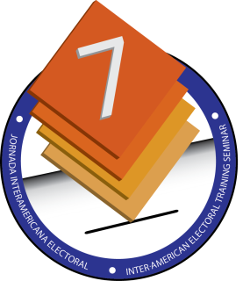
Accessible Elections: Tools and Mechanisms to Facilitate Access to Voting by Persons with Disabilities
Eric Schmidt Fonseca Head of the Department of Electoral Programs
Supreme Court of Elections, Costa Rica
September 22, 2014, Mexico City

Slide 2
Legal Framework
Constitution of Costa Rica, Articles 9 and 99
Law N° 7600 on Equality of Opportunities for Persons with Disabilities
Law N° 8661 Convention on the Rights of Persons with Disabilities
Electoral Code of Costa Rica, Legislative Decree N° 8765

Slide 3
Department of Electoral Programs
Organization
General Office on Voter Registration and Political Party Financing
Department of Electoral Programs
Department of Political Party Financing
Department of Political Party Registration
Characteristics of the electoral programs
What they do and how they are related
24 electoral programs

Slide 4
Access Mechanisms
Program to Create Equal Conditions for Exercising the Right to Vote
Persons with Disabilities and Senior Citizens
Persons Deprived of Liberty
Indigenous Populations
Election Guide Program
Youth volunteers
Program for Adaptation of Voting Booths
Polling Centers

Slide 5
Access Mechanisms
Electoral Code
Article 164—Voting sites
“…[it is] absolutely prohibited to set up sites on second floors or inaccessible places…”
Article 181—Ways that persons who need assistance can vote
Ballot guides
Assisted voting
Public voting
Rule on the Exercise of the Right to Vote in the General Election of February 2, 2014
Article 32—Time allotted for voting
“… the president of the polling station may, within reason, give
persons with disabilities and senior citizens more time than that
established in the previous paragraph.”

Slide 6
Access Tools

Slide 7
Access Tools

Slide 8
Access Tools

Slide 9
IIDH – CAPEL
International Technical Mission Report
“Significant improvements have been identified in terms of the participation of, access by, and services for persons with disabilities. Factors such as structures that enable access to polling centers and the assistance of properly trained staff, as well as their participation as poll workers and assistants, show how the [Supreme Court of Elections] continues to improve on an inclusive process that could end up becoming an example to other electoral institutions of good practices.”

Slide 10
Thank you for your interest

